Slide 1
Data Privacy and Responsibility
SOCM033
Week 8, Term 1 (2022/23)
Silvia Milano – University of Exeter

Slide 2
Mid-term feedback
Click the following link to fill out anonymous mid-module feedback form:
https://forms.office.com/r/gMkVgX9BgX

Slide 3
Assessment reminder
One summative assessment only: Essay (100% of mark)
Due Monday 9 January 2023 at 2pm via BART
BEWARE OF PLAGIARISM
More information here: https://vle.exeter.ac.uk/course/view.php?id=1977
Marking criteria:
https://vle.exeter.ac.uk/course/view.php?id=9850
WATCH VIDEO ON ELE (“Assessment information”)

Slide 4
This week
The concept of privacy
The concept of privacy
Differential privacy
Privacy and the ownership of data
Responsible work with data
From data privacy to data protection
Ethics in data work

Slide 5
This week
The concept of privacy
The concept of privacy
Differential privacy
Privacy and the ownership of data
Responsible work with data
From data privacy to data protection
Ethics in data work

Slide 6
The concept of privacy
Privacy as access to things deemed private.
Privacy is violated when somebody accesses private information without authorisation.
Privacy as control over what we deem private.
Privacy is violated when somebody holds private information without authorisation (even if they do not in fact access it).
Example: customer data leak.
Privacy as control is violated.
Privacy as access is not violated if no-one sees or uses the leak data.

Slide 7


The concept of privacy
Importance of context

Slide 8
Privacy and security
Often, the right to privacy is portrayed as contrary to the interest of security.
However, the two are complementary.

Slide 9
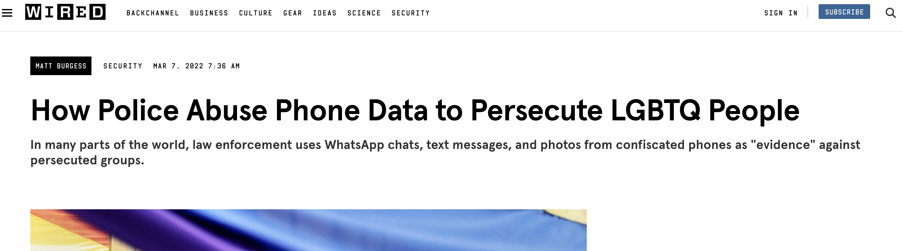
Privacy and security
Privacy is important even if you have done nothing wrong!
Protection from unjust prosecution
Example: during WWII, occupying Nazi forces in France used public records to prosecute members of the Jewish community.
Always the potential for data leakages
Maintaining a private sphere is of intrinsic value
Example: right to be forgotten.

Slide 10
Differential Privacy
The release of data sets and open data may be beneficial for public research that brings public values, and for limiting the power of corporations (see week 5 on data governance).
But data reuse may have negative repercussions on data subjects.
Aspects covered by GDPR.
FAIR data.
Differential privacy gives additional tools.
Wikipedia definition: “Differential privacy is a system for publicly sharing information about a dataset by describing the patterns of groups within the dataset while withholding information about individuals in the dataset.”

Slide 11
Differential Privacy
The release of data sets and open data may be beneficial for public research that brings public values, and limiting the power of corporations (week 5).
But data reuse may have negative repercussions on data subjects.
Aspects covered by GDPR.
FAIR data.
Differential privacy gives additional tools.
Wikipedia definition: “Differential privacy is a system for publicly sharing information about a dataset by describing the patterns of groups within the dataset while withholding information about individuals in the dataset.”
Issue of controversial standards

Slide 12
Privacy and the ownership of data
Should individuals retain ownership of their personal data?
They could derive a profit from selling rights to it.
Subsequent exchanges could be subject to traceability requirements.
Privacy is not like property:
Some information should never become data in the first place.
Market models of the value of data are inadequate: power asymmetries mean that data has much more value for companies and governments than for individuals.
Individuals do not have full authority to sell their personal data, as this can have an impact on others.

Slide 13
This week
The concept of privacy
The concept of privacy
Differential privacy
Privacy and the ownership of data
Responsible work with data
From data privacy to data protection
Ethics in data work

Slide 14
From data privacy to data protection
Data privacy: narrow focus on avoiding reference/storage of personal data
key issue is whether data are “sensitive” in a direct sense
Data protection: broader focus on
Various types of data that could cause harm to data subject (including indirectly)
Various ways types of DATA USE that could cause harm to data subject (including via data linkage and aggregation)
See GDPR

Slide 15
Which data are ethically sensitive?
Data about INDIVIDUALS
The lack of transparency, technical understanding and accessible complaint procedures constitute serious obstacles to people’s ability to question discriminatory practices

Slide 16
Which data are ethically sensitive?
Data about GROUPS
environmental and climate data contribute significantly to the production of knowledge pertaining to people’s habits and preferences.
Some uses of such data pose a risk to collectives – that is, any social groupings brought together by a common location, characteristic or purpose and/or long-standing personal ties.

Slide 17
Example: Using Twitter data to track seasonality of respiratory diseases
This research can inform hospital resourcing and save lives.
Tweets provide useful information that cannot be found anywhere else.

Slide 18
Example: Using Twitter data to track seasonality of respiratory diseases
However, twitter users have not provided such information with the intention of participating in research.
No consent explicitly collected from users.
Dubious accuracy and veridicity of the data.
Also, Twitter data are problematic: mostly urban users with easy access to hospitals and less exposure to environmental stressors

Slide 19
Example: Using Twitter data to track seasonality of respiratory diseases
Is this “good” or “bad” research?
How to make it more sound and more ethical?

Slide 20
Ethics in data work: from “macroethics” to “microethics”
Data ethics: the study of what it means for data work to be socially responsible and beneficial to life on earth.
From “high-level” case studies to individual agency.
From “why” to “how” to act.
Principles are not like rules! They do not tell you what to do.

Slide 21
Ethics in data work: from “macroethics” to “microethics”
Key ethical principles according to Floridi and Cowls (2019):
Beneficence
Nonmaleficence
Autonomy
Justice
Explicability (which includes intelligibility and accountability)

Slide 22
Ethics in data work: from “macroethics” to “microethics”
Abandon the idea that in order to make an evaluation on the ethical potential of innovation we need to make a precise forecast as to its potential social impact.
It is unrealistic to expect that the analysis of potential ethical and social implications can only be effective if it is based on a precise prediction of the future impact of data work.
Abandon the idea that research should only focus on innovation with positive social repercussions.
Design data and systems for auditability.

Slide 23
Ethics in data work: from “macroethics” to “microethics”
“Data are people” and can do harm;
Debate the tough ethical choices;
Engage with the broader consequences of data and analysis practices.
Look out for any potential new users of the knowledge that is being produced, their reasons, who is excluded and who is included in potential use and how the research process can be changed to make the results less discriminating, more sustainable and more or less inclusive depending on the requirement.

Slide 24
Who is responsible?
Institutional, infrastructural and cultural conditions (data governance).
Decisions by non-humans like robots and autonomous algorithms (“infraethics”, Floridi 2012, 2015).
Decisions by data subjects.
... What can data scientists be responsible for? Is it fair to expect data scientists to take responsibility, given the constraints imposed on their work and the often stringent demands of their employers and customers?

Slide 25
Who is responsible?
Institutional, infrastructural and cultural conditions (data governance).
Decisions by non-humans like robots and autonomous algorithms (“infraethics”, Floridi 2012, 2015).
Decisions by data subjects.
... What can data scientists be responsible for? Is it fair to expect data scientists to take responsibility, given the constraints imposed on their work and the often stringent demands of their employers and customers?

Slide 26
Who is responsible?
Institutional demands do not typically determine every aspect of data work!
Data scientists need to:
Abandon the myth of neutrality that depicts data science as the blind churning of numbers and code, devoid of commitments or values except for the aspiration towards increasingly automated reasoning.
Identify and regularly re-assess their space of agency (and accountability).
Critically consider the broader work context and whether/how to raise concerns and signal problems.
Consult diverse expertise to help identify issues.

Slide 27
When to do this?
All stages of data work, including:
when evaluating whether to participate in a given project or call for funding;
when designing the research plans and choosing methods and relevant stakeholders;
when considering how to interpret and communicate project results.

Slide 28
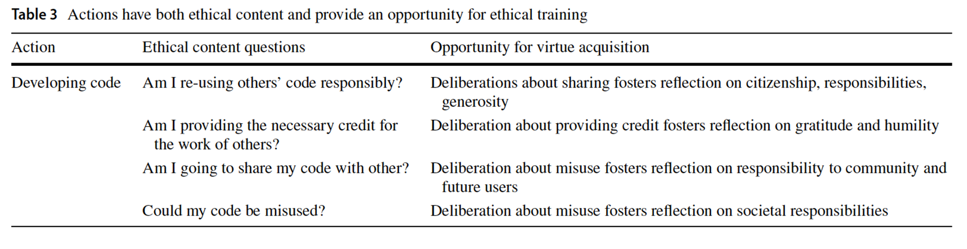
When to do this?
Bezuidenhout and Ratti, 2020

Slide 29
Summary
The concept of privacy
The concept of privacy: control vs. access and the importance of context
Differential privacy offers new tools, but more needs to be done to develop robust systems.
Privacy and the ownership of data: data is not like other forms of property. Individuals do not always have the authority to sell personal data.
Responsible work with data
From data privacy to data protection: privacy has a narrow focus on sensitive data. Protection has a wider focus on what kind of data practices could harm subjects.
Ethics in data work needs to be implemented at all stages of data journeys, goes beyond adherence to existing laws and internal regulations. Translating ethical principles into practice requires contextual responsibility.

